Slide 1
Visualizing Conflict
Violence against civilians and armed nonstate actor attributes
PLSC 31101
Madeleine Stevens
10 December 2019

Slide 2
The Datasets
UCDP One-Sided Conflict Dataset (1989-2018)
Sexual Violence in Armed Conflict Dataset (SVAC, 1989-2015)
UCDP Georeferenced Event Dataset (1988-2018, minus Syria)
Women in Armed Rebellion Dataset (WARD, 1964-2014)

Slide 3
The Challenges
Merging the data appropriately
Making static maps
Making interactive maps
Figuring out how to present interactive maps

Slide 4
Visualizing the data: Regional Distribution

Slide 5
Visualizing the data: Female Membership

Slide 6
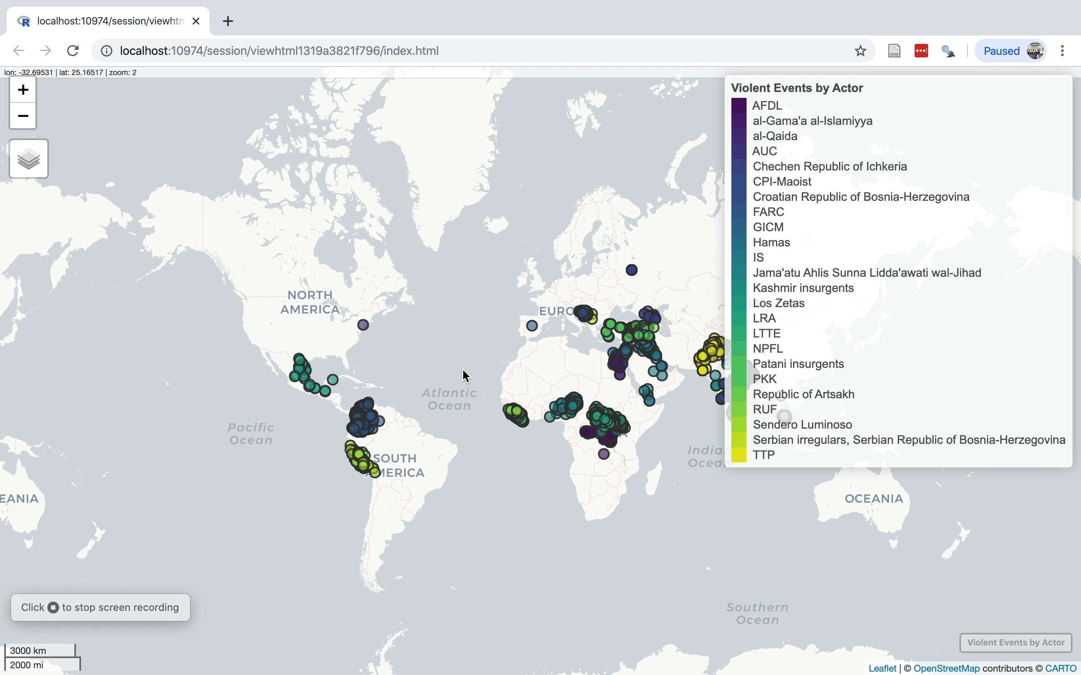
Interactive map 1: Violent Events by Group

Slide 7
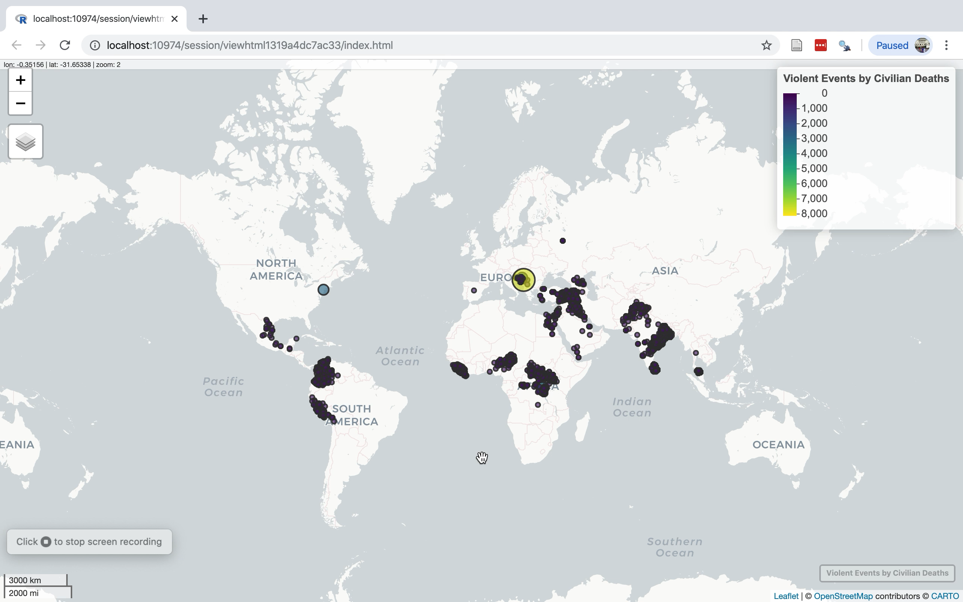
Interactive map 2: Violent events sized by death count

Slide 8
Conclusions
Not enough data to draw conclusions about female group membership or even sexual violence
Interactive maps are not terribly hard but saving them is (computer crashes!)

